Slide 1

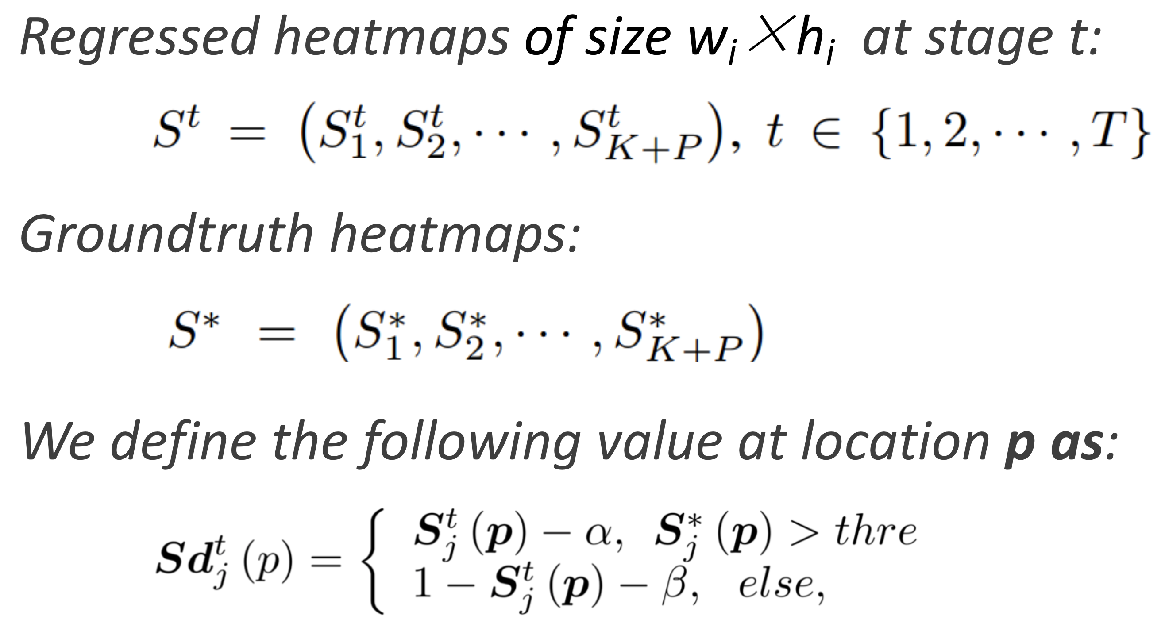
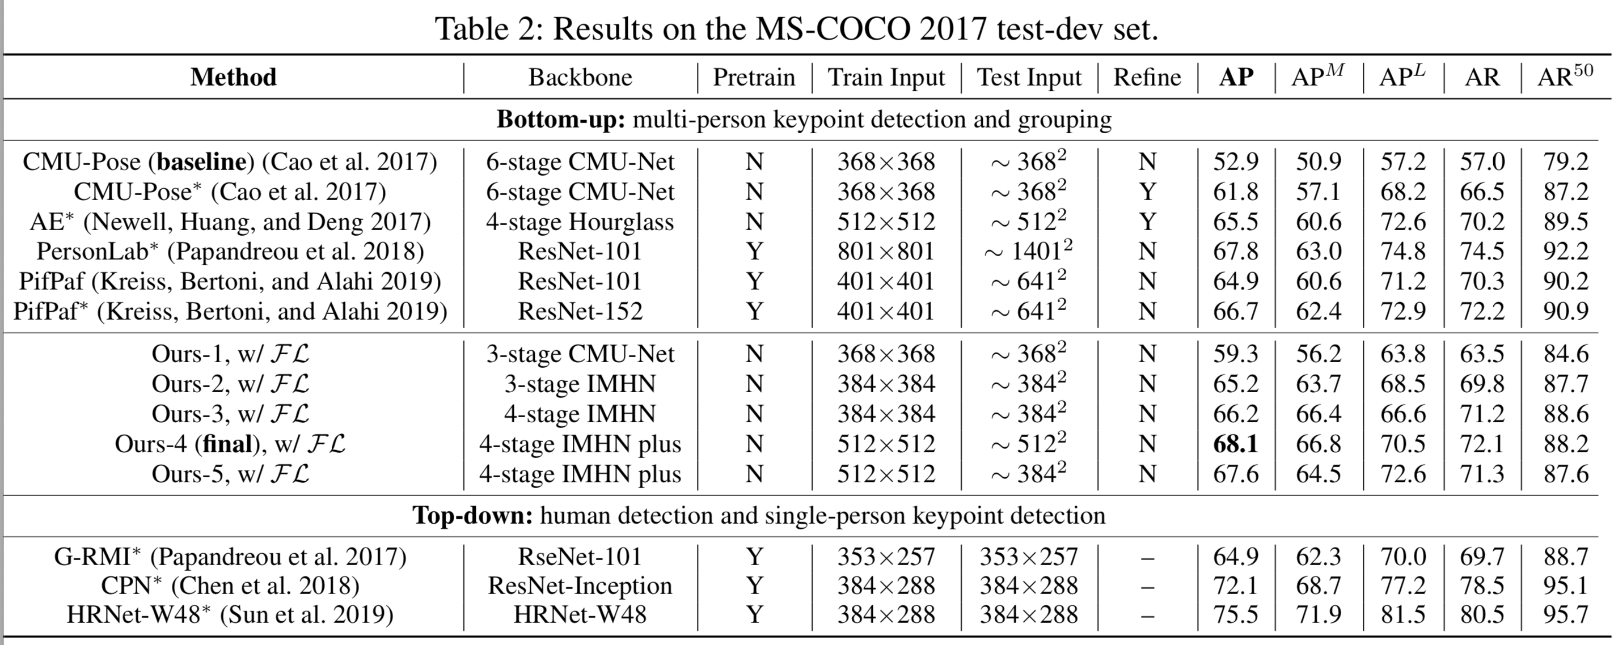
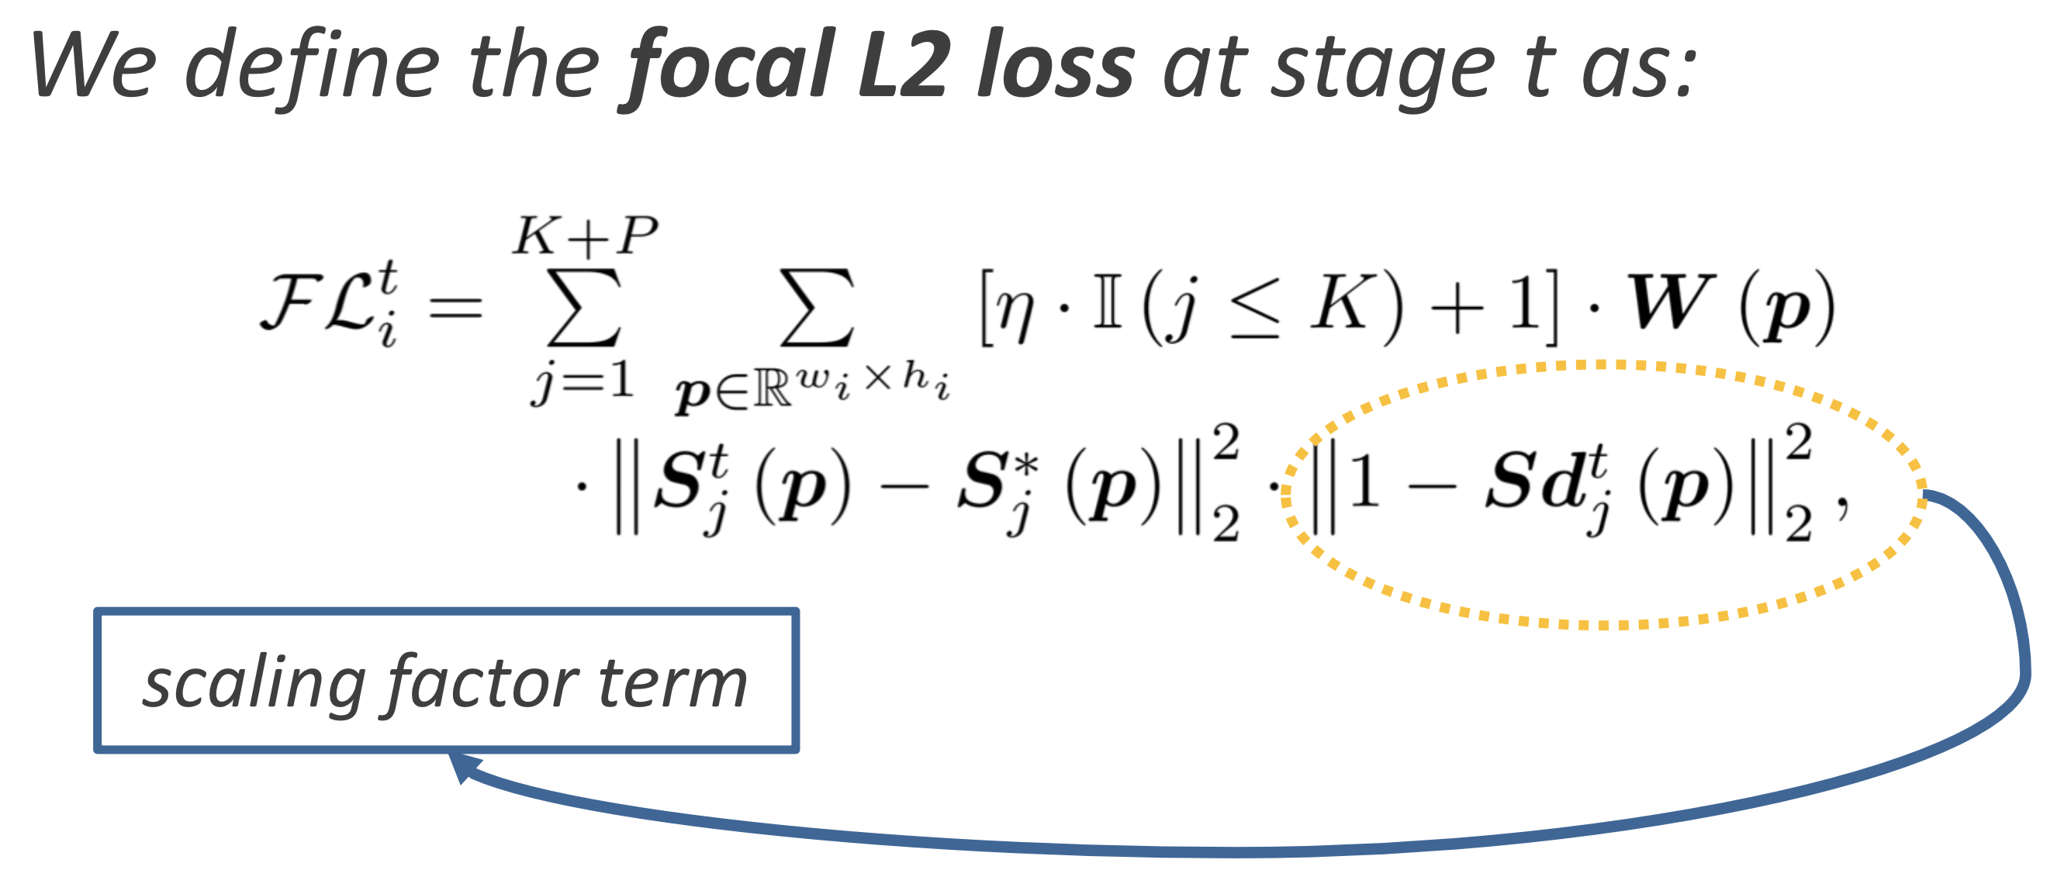
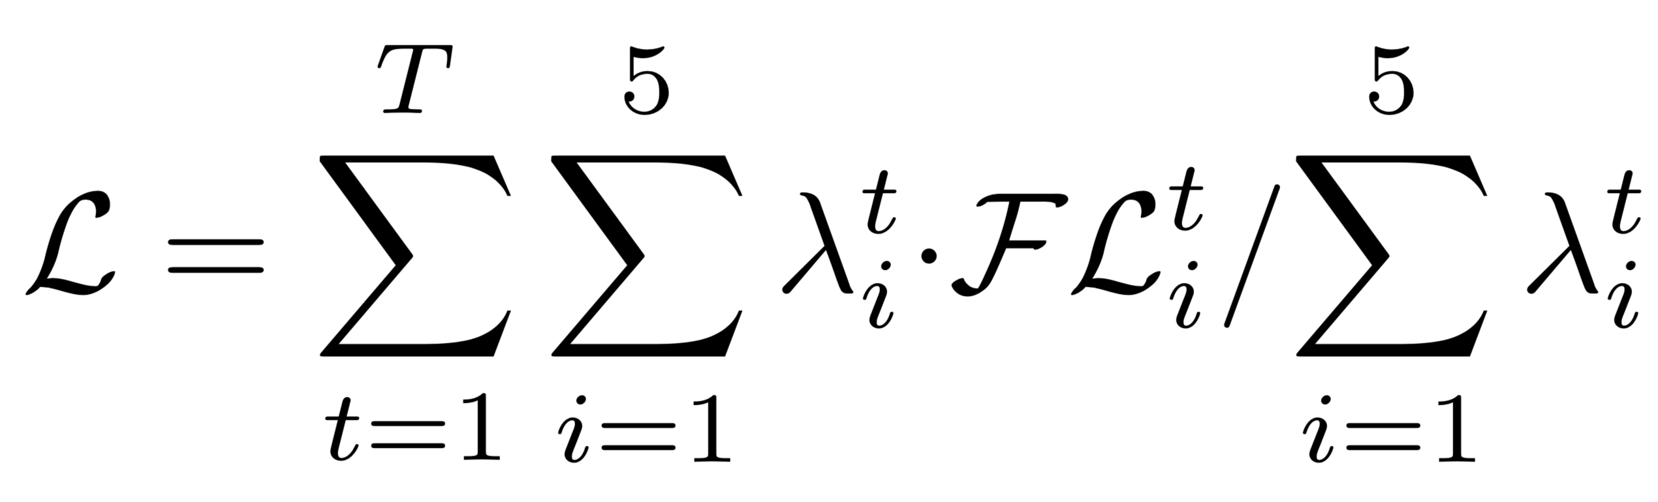
Simple Pose: Rethinking and Improving a Bottom-up Approach for Multi-Person Pose Estimation
Jia Li ¹, Wen Su and Zengfu Wang
¹ Department of Automation, University of Science and Technology of China
Code: https://github.com/jialee93/Improved-Body-Parts Email: jialee@mail.ustc.edu.cn
AAAI 2020
Paper ID: 2987
INTRODUCTION AND RETHINKING
OUR WORK AND CONTRIBUTIONS
Introduction:
The problem of multi-person pose estimation aims at recognizing and localizing the anatomical keypoints (or body joints) of all persons in a given image. In this paper, we rethink a well-known bottom-up approach (we refer it to as CMU-Pose here) for multi-person pose estimation and propose an improved one.
Rethinking:
The topic of scale invariance in pose estimation is of great importance.
High-res and high-quality feature maps (include the output heatmaps) are critical for accurate keypoint localization.
The encoding of connection (or association) information between keypoints.
The problem of imbalanced data: “positive samples vs “negative samples (be- tween classes) and “easy samples vs “hard samples (within classes).
The improved approach surpasses the baseline significantly thanks to:
an intuitional yet more sensible representation, which we refer to as body parts to encode the connection information between keypoints,
an improved stacked hourglass network with attention mechanisms,
a novel focal L2 loss which is dedicated to “hard” keypoint and keypoint association (body part) mining,
the robust greedy keypoint assignment algorithm for grouping the detected keypoints into individual poses.
Our approach works straightforwardly yet outperforms the baseline (CMU-Pose) by about +15% AP (average precision) and is comparable to the state of the art on the MS-COCO test-dev dataset. The code and pre-trained models are publicly available on github.
HEATMAP DEFINITION AND NETWORK ARCHITECTURE
Deﬁnition of heatmaps. Left: examples of keypoint Gaussian peak and body part Gaussian peak. Middle: the human skeleton. Right: examples of the inferred heatmaps by our network in practice. Our network is supervised to regress the Gaussian responses (0∼1) around the keypoint or body part area.
Identity Mapping Hourglass Network (IMHN) with spatial attention and channel attention mechanisms. The feature maps at 5 different scales are extracted from each (stage) hourglass module and they are used to produce heatmaps of different scales. Only the heatmap regression at the 1/4 scale is illustrated due to space limitation. An SE (squeeze and excitation) block is inserted into each feature map at each scale to learn the channel relationships.
FOCAL L2 LOSS FUNCTION
EVALUATION
The L2 loss is frequently used to measure the distance between the predicted heatmaps and the target heatmaps. Here, we present a novel loss, which we refer to as focal L2 loss, under the uniﬁed deﬁnition of keypoint and body part heatmaps, to deal with the two types of sample imbalance problems as introduced in the INTRODUCTION above.
Qualitative comparison between our approach and CMU-Pose (Cao et al. 2017). Left: results produced by CMU- Pose. Right: our results. By comparison, our approach is more accurate in keypoint localization and more robust to complex poses and moderate overlaps.
Comparison with the State-of-the-art
The experimental results have demonstrated the significant improvement achieved by our approach over the baseline (+15.1% AP on the MS-COCO test-dev dataset). To the best of our knowledge, our approach, which is straight-forward and easy to follow, is the first bottom-up approach to provide both the source code and pre-trained models with about 68% AP on the MS-COCO test-dev dataset. The last but not least, we provide some insights into valuable design choices for multi-person pose estimation.
Please refer to more details in our paper and github page if you are interested in our work.
The total loss of the stacked IMHN across 5 different scales can be written as:
,
in which λ_{i} is to balance the losses at different scales.

